Slide 1

Application: BiteBuddy Type: Application Architecture View: Logical View Style: Layered Architecture Pattern
Users
Delivery Channels
Core Business Processes
Data And Information
Technology Enablers
User Management
Payment Gateways
Food Ordering & Checkout
User Data
Restaurants
Web Browser
Swiggy API
Table Reservations
Restaurant Data
Payment Confirmation
Order Data
Cloud Services (AWS )
Diners
Review & Rating
Transaction Data
SMS Service
Customer Support
Review Data
Web Browser
Github & Delivery Pipeline
Restaurant Management
Financial Reports
Administrators
(Platform Administration,
Finance & Operations Team,
Advertising Management Group,
Customer Support Team)
Database (MySQL)
Advertisement & Promotion
Advertisement Analytics
Security (Firebase & OAuth)
Financial Reporting

Slide 2
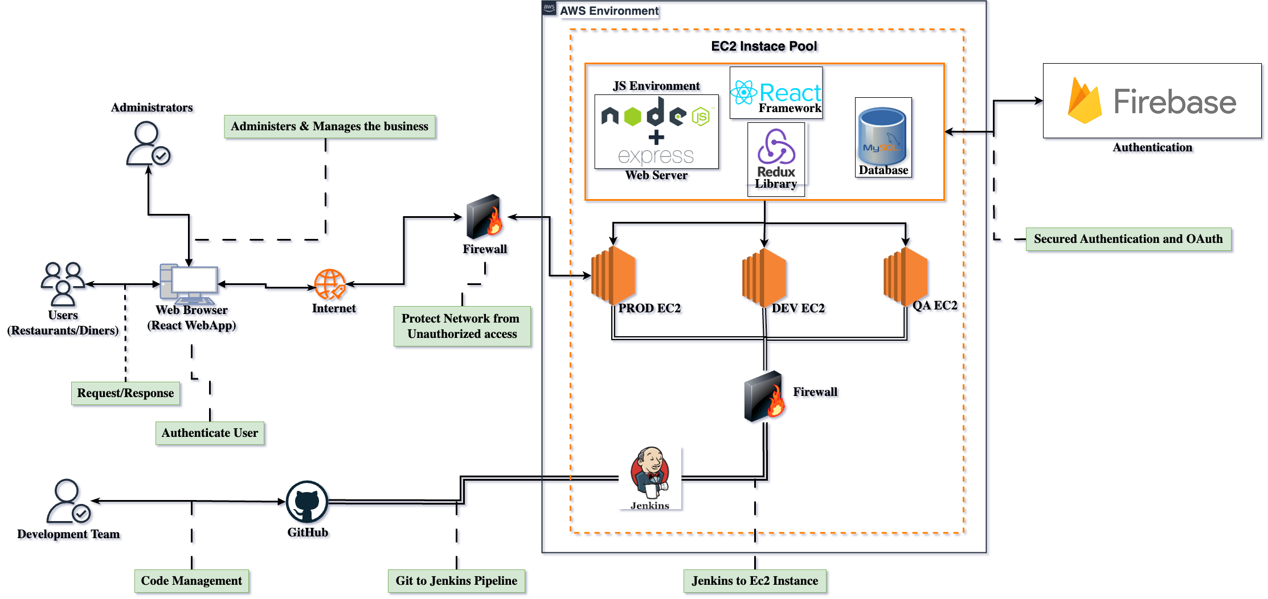
Application: BiteBuddy Type: Application Architecture View: Process View Style: Client-Server Pattern

